Slide 1

Quality Engineering and Management Company Limited

Slide 2

Brief Introduction
Company Back Ground:
Small & Medium Enterprise since 1996. Company Incorporation in 2017. Company Registration No. 111217394
Office / Workshop Address:
No. 191/174, Mahar Thiri Road, 77 Quarter, Dagon Seikkan Township, Yangon, Myanmar.
Contact Detail:
Email. kst.qem@gmail.com
Tel. (+95) 9 975356907, (+95) 9 775171345, (+95) 9 799345653
Viber, WhatsApp, Zalo. (+95) 9975356907
Website. www.qemcompany.com

Slide 3
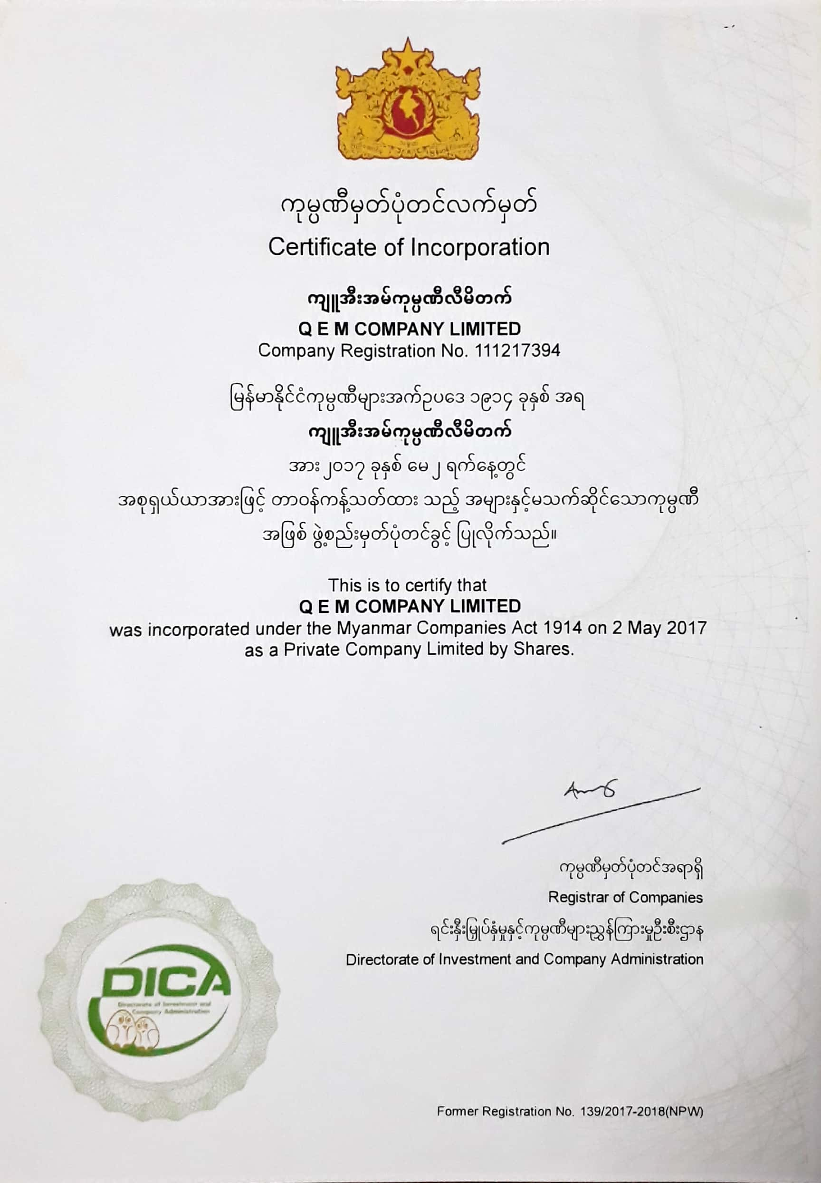
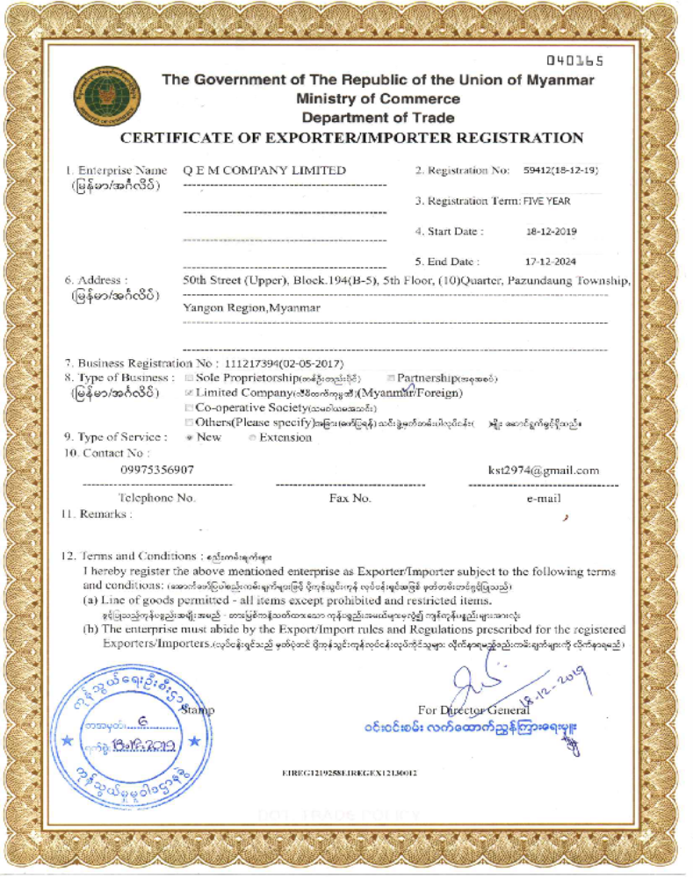
Certificate of Incorporation

Slide 4
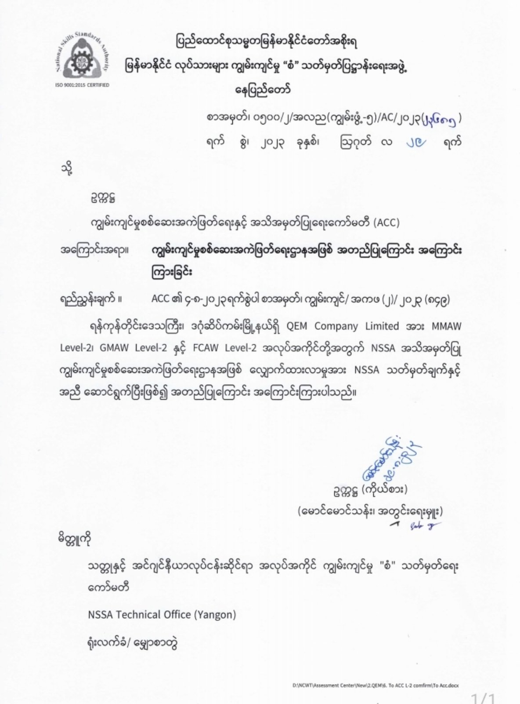
NSSA ACCREDITED ASSESSMENT CENTER
QEM Company Limited is an Accredited Assessment Center of National Skills Standard Authority (NSSA).

Slide 5
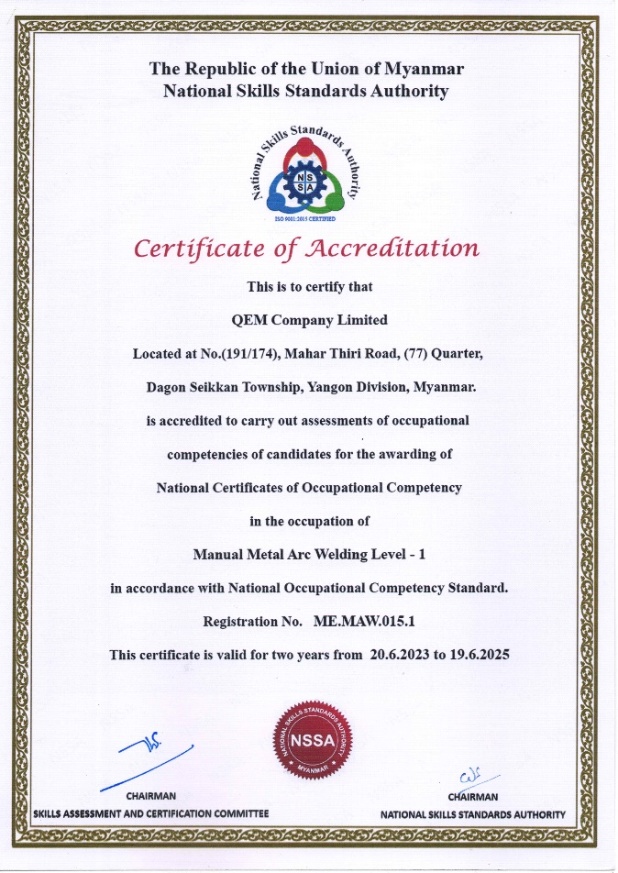
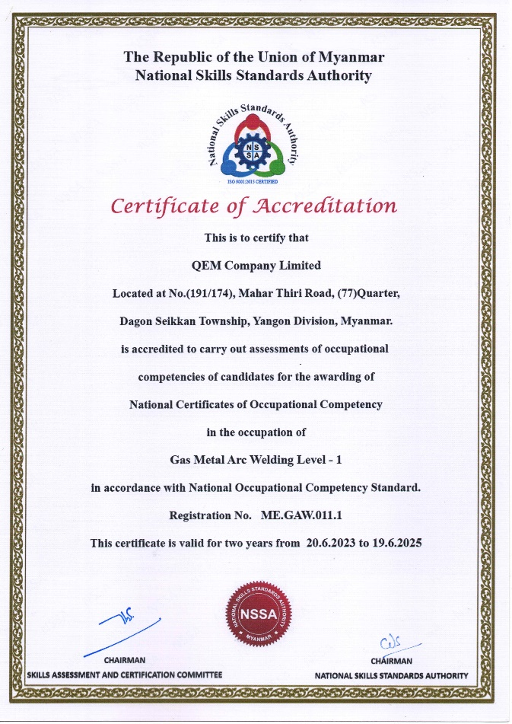
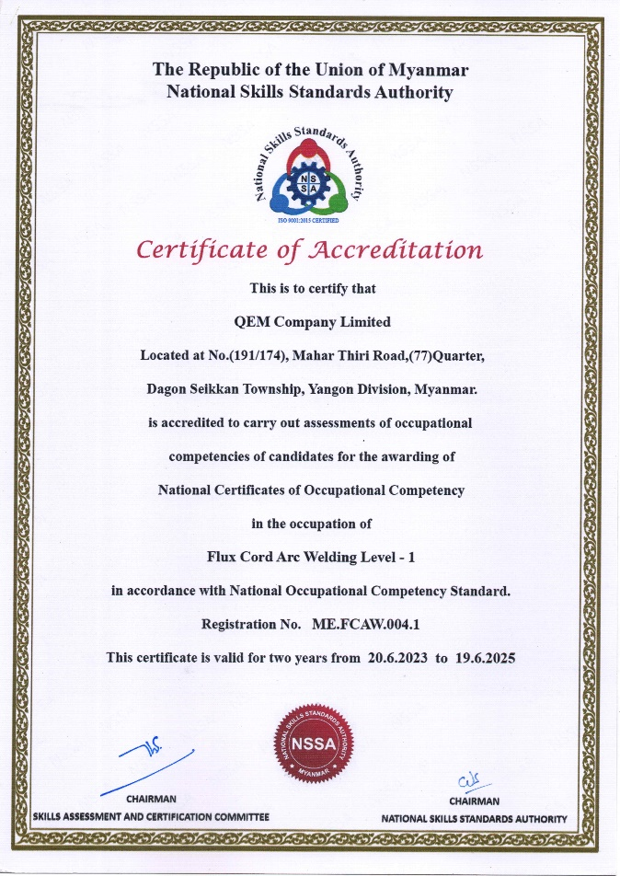
NSSA ACCREDITED ASSESSMENT CENTER

Slide 6
Mission, Vision & Core Values
Mission
We are an agile, innovative process and mechanical solutions provider dedicated to delivering value through Quality and Safety with Integrity, Teamwork, and Dependability.
Vision
Strive to be the "Preferred Service Provider" with our Better Business Performance, Customer Satisfaction and Continual Improvement in the delivery of Quality product & Services.
Core Values
Safety : Maintain uncompromised safety standards at work and in our everyday lives.
Quality : Provide innovative quality products and services, employing best known methods, while striving for continuous improvement.
Integrity : Exercise the highest ethical standards. Take personal responsibility for our actions and treat everyone with trust and respect.
Teamwork : Continually learn and share ideas and knowledge, and promote collaborative efforts across all internal and external aspects of our business.
Dependability : Take ownership to meet our commitments to our customers and employees.
Social Responsibility : Maintain a balance between our professional endeavors, family lives, communities, and the environment.

Slide 7
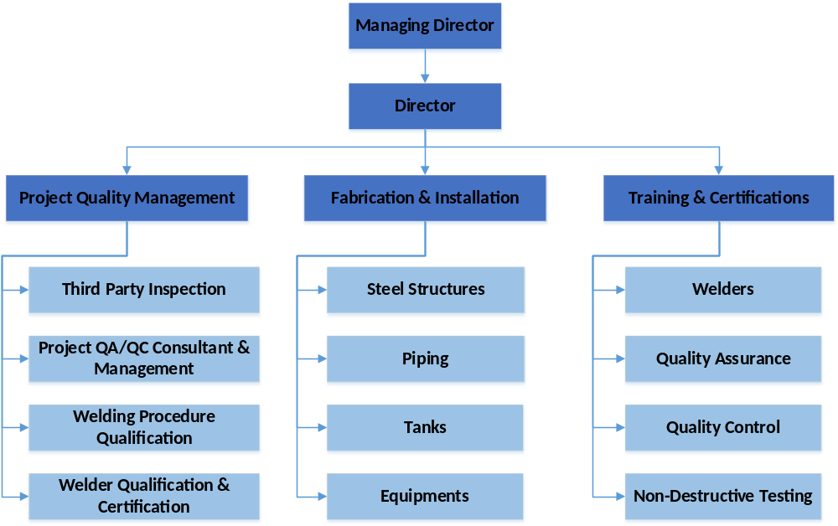
Organization Structure

Slide 8
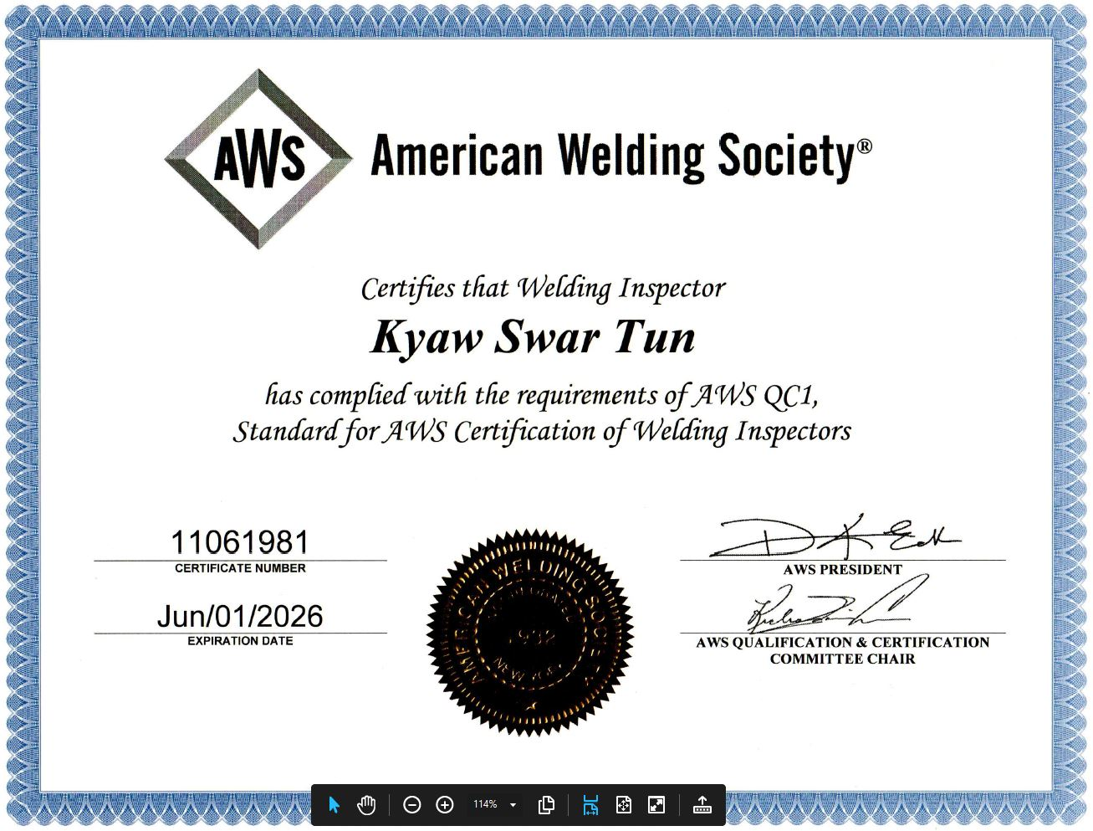
Welding Related Technical Qualification

Slide 9
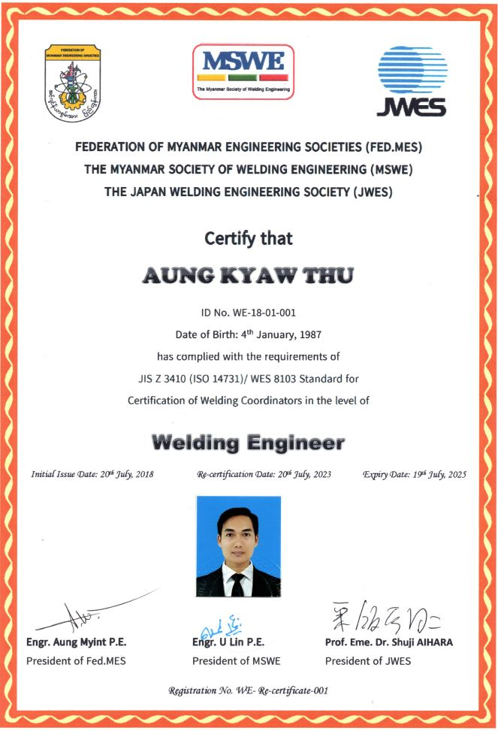
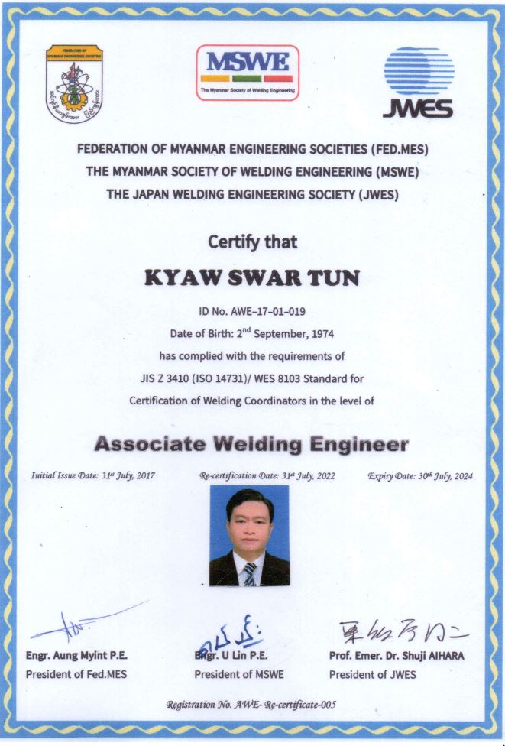
Welding Related Technical Qualification

Slide 10
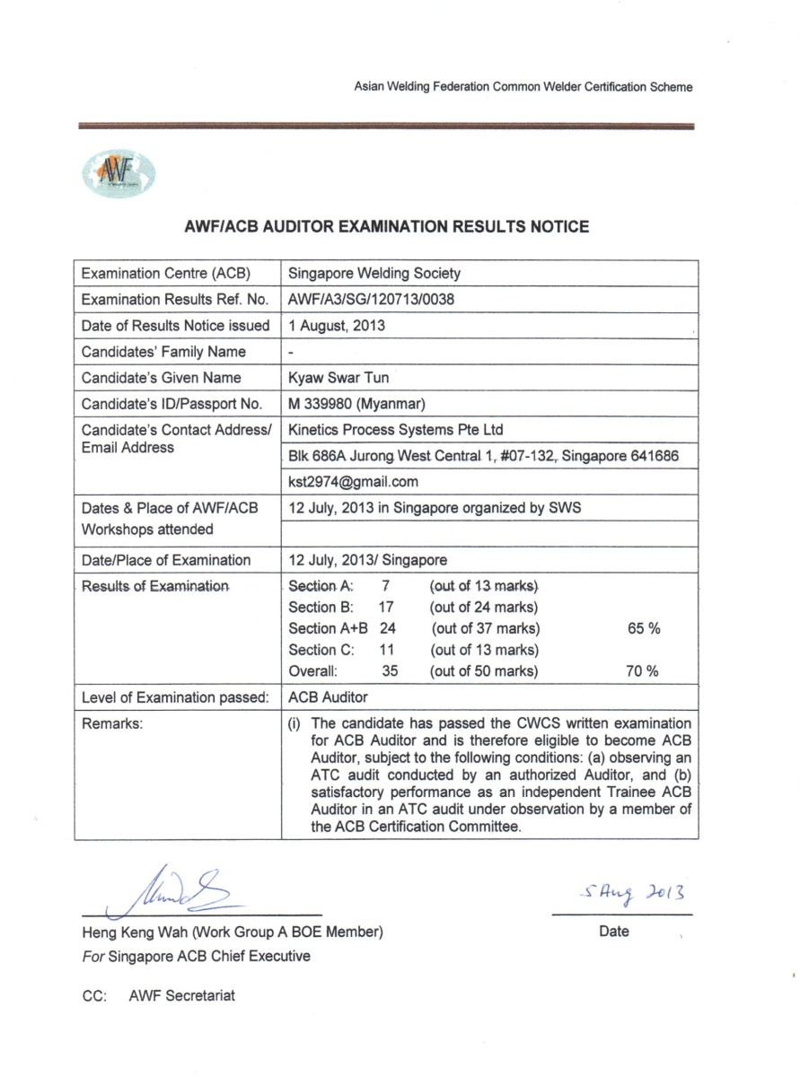
Welding Related Technical Qualification

Slide 11
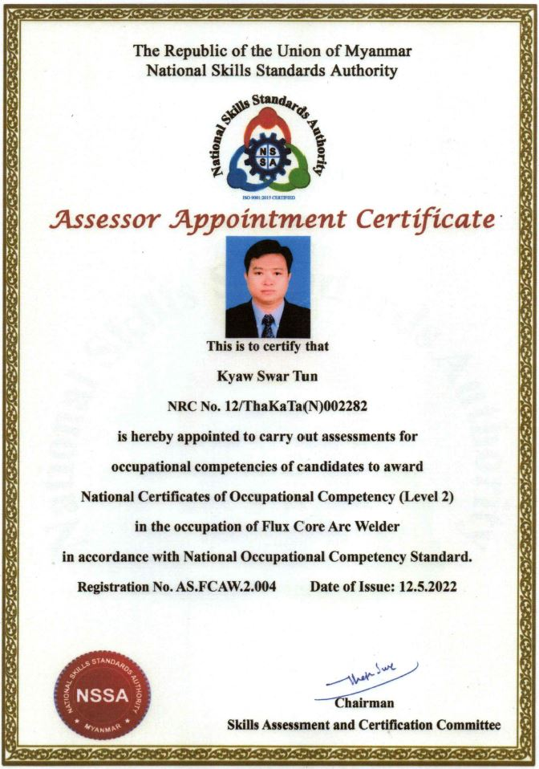
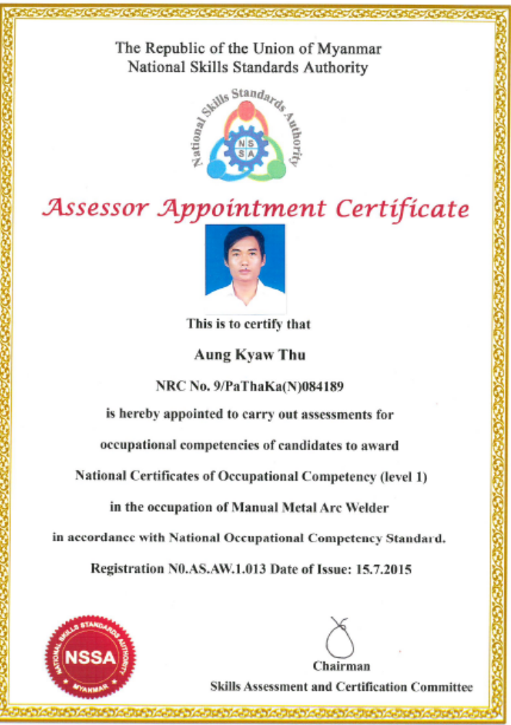
NSSA ASSESSOR QUALIFICATION

Slide 12
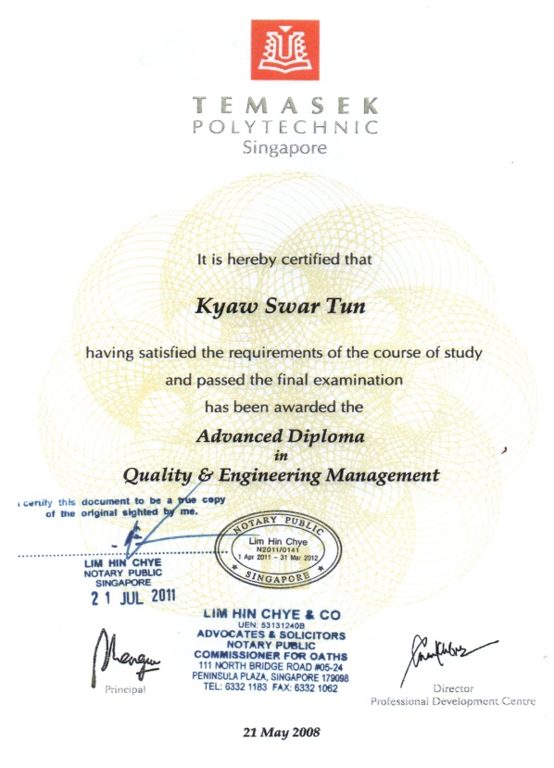
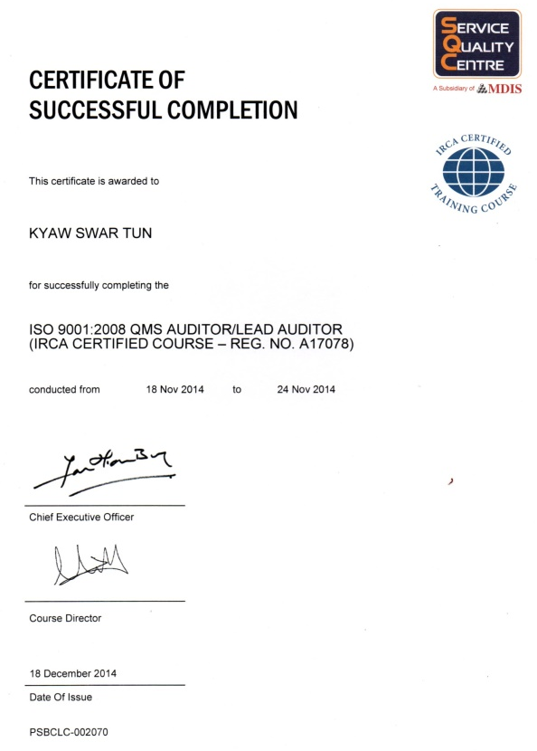
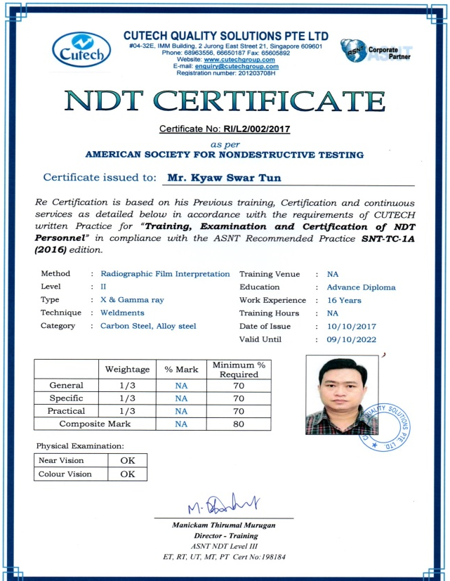
Quality Certification

Slide 13
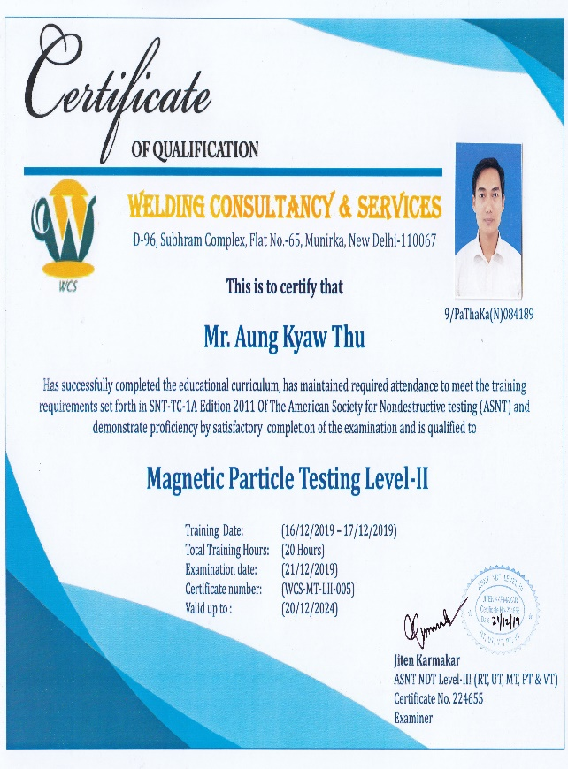
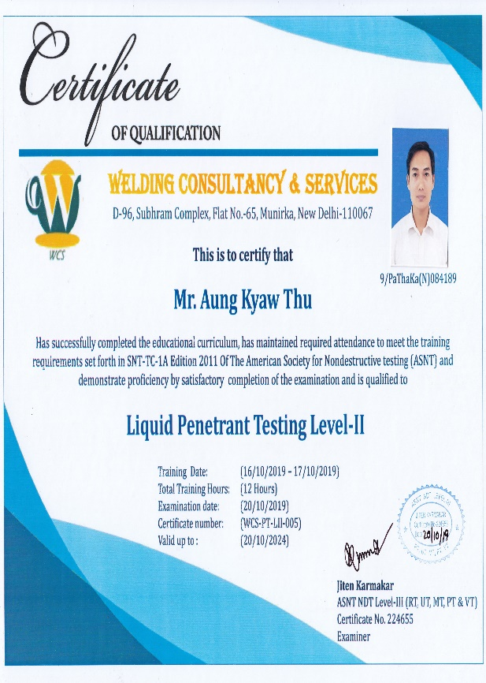
Quality Certification

Slide 14
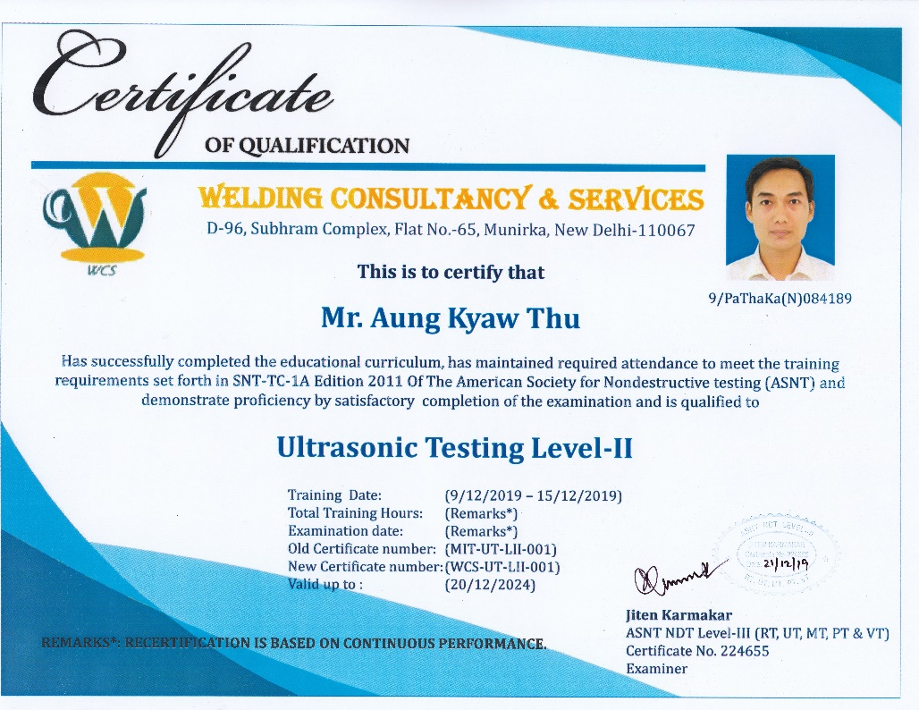
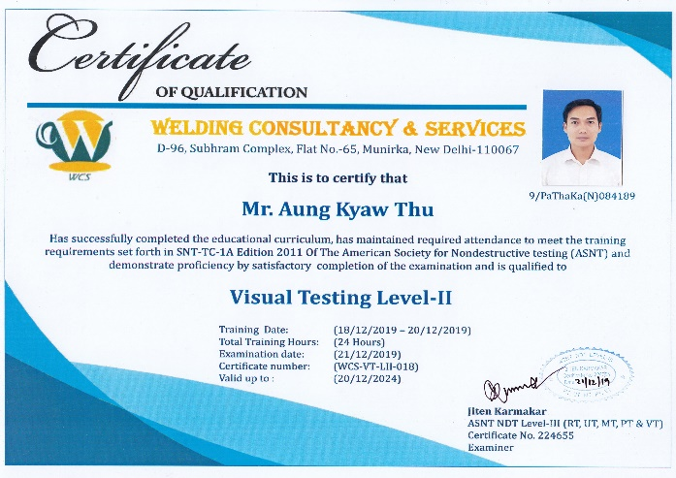
Quality Certification

Slide 15
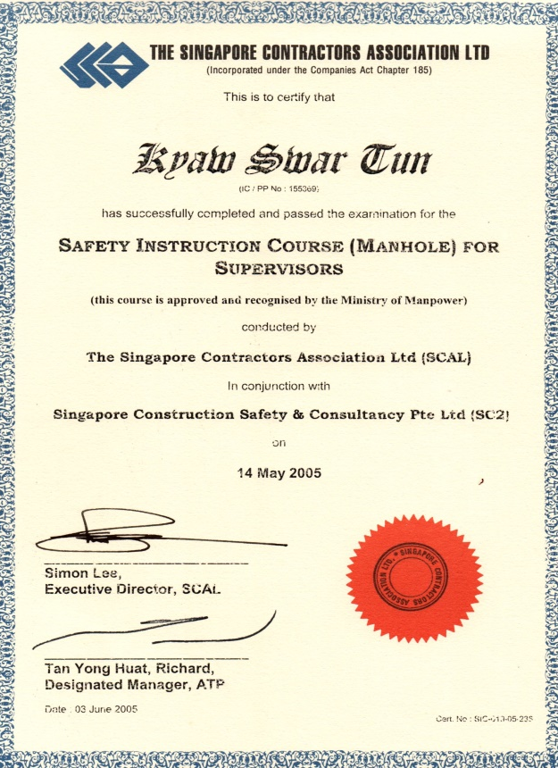
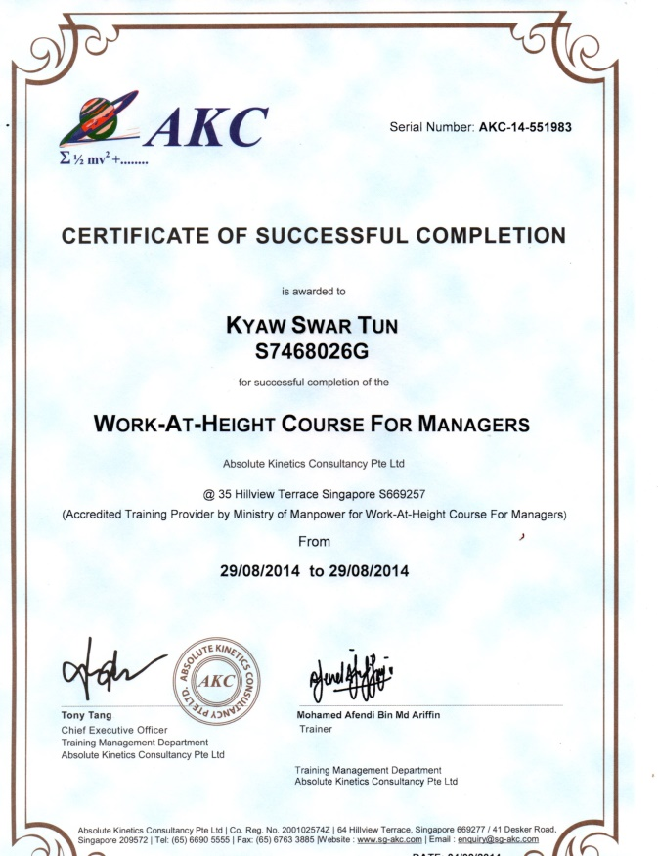
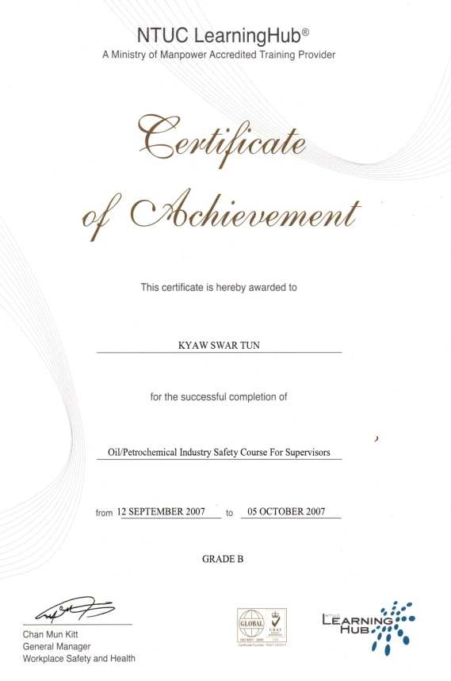
Safety Certification

Slide 16
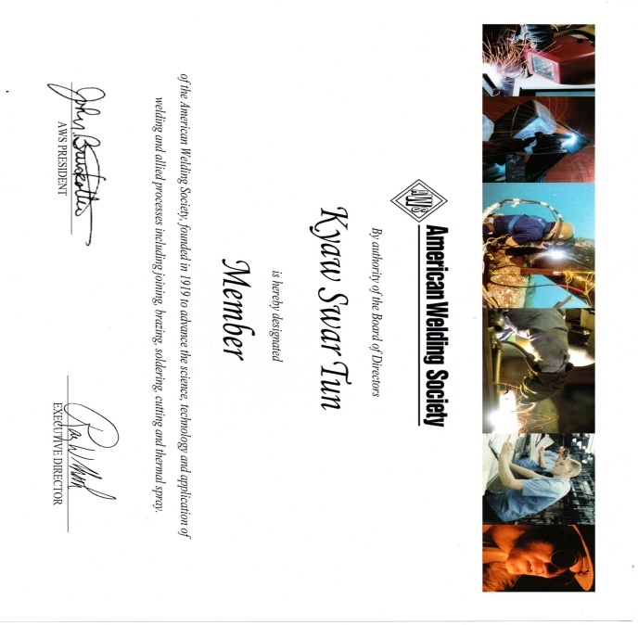
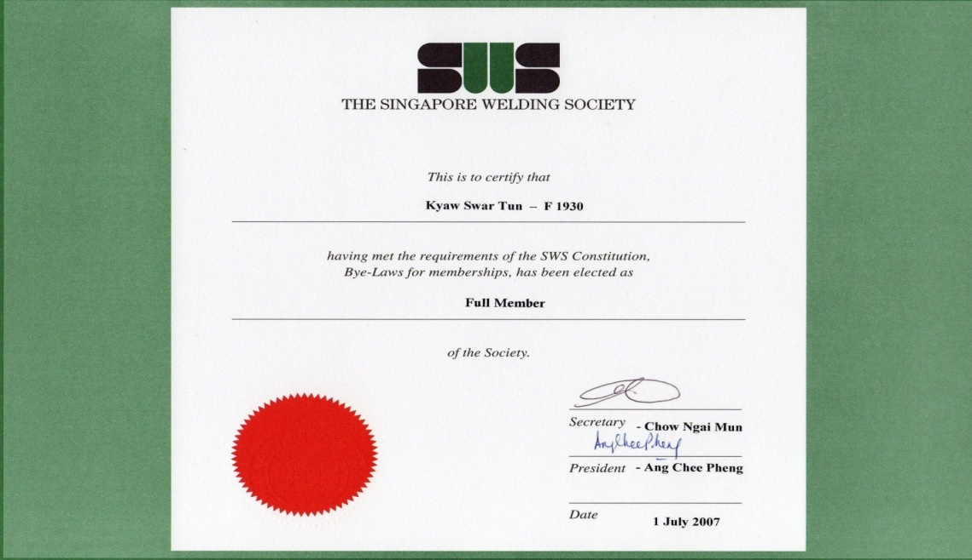
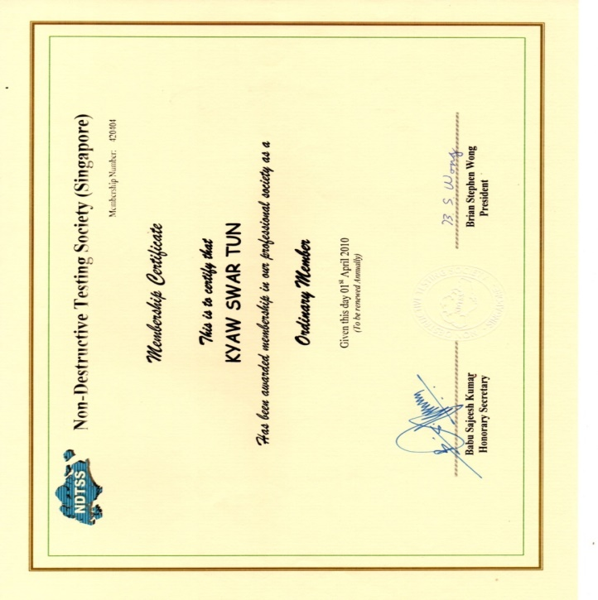
International Membership

Slide 17
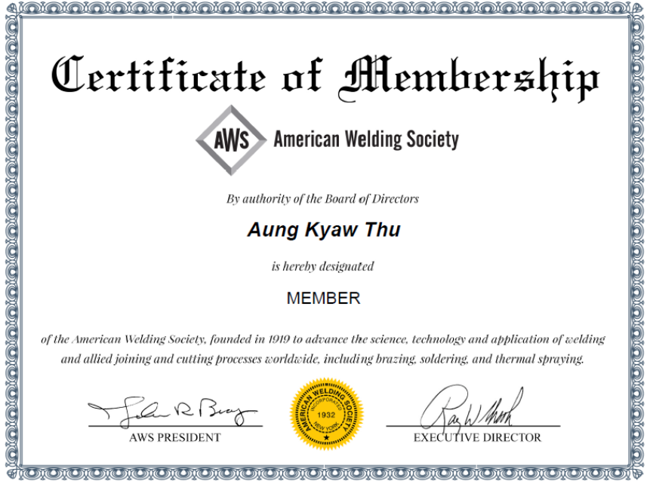
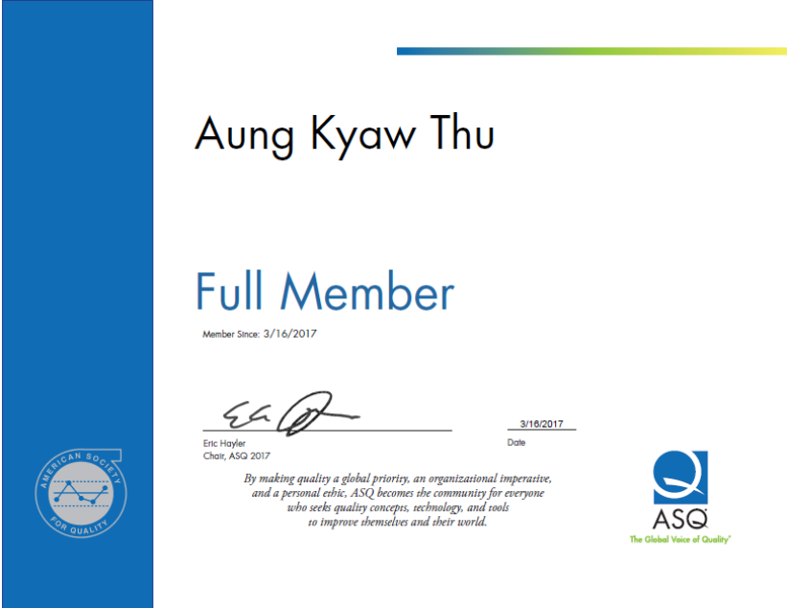
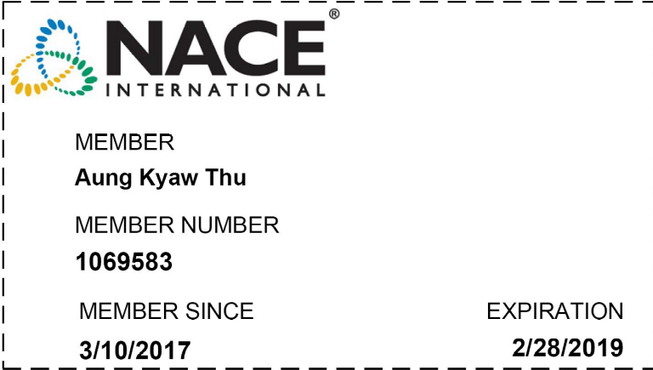
International Membership

Slide 18
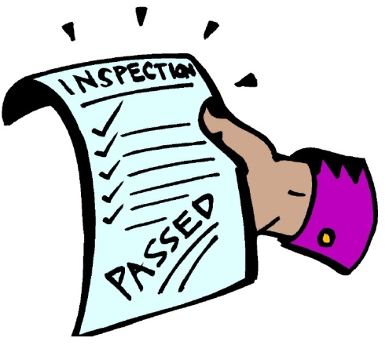


Our Services
1) Project Quality Management / 3rd Party Inspection Services
2) Training and Certification Services
3) Fabrication and Installation Services

Slide 19

Our Services # 1
Project Quality Management / 3rd Party Inspection Services
  Preparation and Implementation
    Project Quality Plan (PQP)
    Inspection & Test Plan (ITP)
    Quality Control Dossier (QCD)
    Manufacturer Data Record (MDR)
    Project Quality Auditing
    3rd Party Consultancy Services
  Testing, Qualification & Consultancy
  Welder Performance Qualification Test (WPQT)
  Welding Procedure Qualification Test (WPS/PQR)
  Non-Destructive Testing (NDT – RT, UT, PT, MT, VT)
  Various type of Inspection in Mechanical Fabrication & Installation
  Welding related advisory and consultancy services

Slide 20
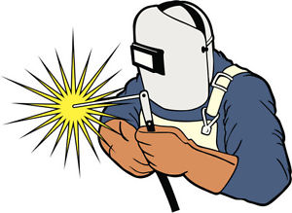
Our Services # 2
2) Training and Certification Services
Welder
  Accordance with AWS D1.1 / ASME Sec. IX
  Accordance with Myanmar’s Nation Skill Standard Authority (NSSA)
  Welding Processes – GTAW / SMAW / GMAW / FCAW / OAW
Inspector
    NDT Inspector Training accordance with ASNT recommended practice SNT-TC-1A
    Welding Inspector Training accordance with AWS QC1
    QA/QC Inspector Training for Piping, Steel Structure, Storage Tank, Static & Rotating Equipment's.

Slide 21
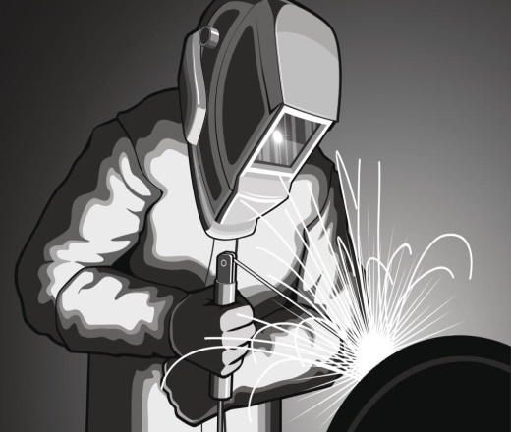
Our Services # 3
3) Fabrication and Installation Services
Process, Chemicals, Utilities and Fire Water Piping System
  Metallic Piping / Tubing (Carbon Steel / Stainless Steel / Alloy / Copper & etc.)
  Thermoplastic Piping (PVC, PPH, HDPE, PTFE, PVDF & etc.)
Steel Structure (Workshop, Factory, Apartment, Link Bridge & etc.)
Boiler Erection, Static & Rotating Equipment Installation
Storage Tank Erection
Aluminum Internal Floating Roof (IFR) Installation
(Honeycomb Type and Pontoon Type)
Insulation and Cladding Work
Hot Tapping, Mechanical & Chemical Flushing
Welding related modification and repair work

Slide 22
Complied with International Code and Standard
Accordance with Project / Client Requirements
Welding Procedure Qualification (WPQT) & Welder Qualification (WQT) shall be complied with ASME Sec. IX and AWS D1.1
Non-Destructive Examination shall be accordance with ASME Sec. V
Piping fabrication & installation
  Power Piping installation shall be complied with ASME B31.1
  Process Piping installation shall be complied with ASME B31.3
  Pipelines and Related Facilities shall be complied with API 1104
Steel Structure fabrication & installation shall be complied with AWS D1.1
New Tank fabrication & erection shall be complied with ASME Sec. VIII / API 650
Tank repair & alteration work shall be complied with API 653
Static / Rotating Equipment installation shall be complied with API RP 686

Slide 23
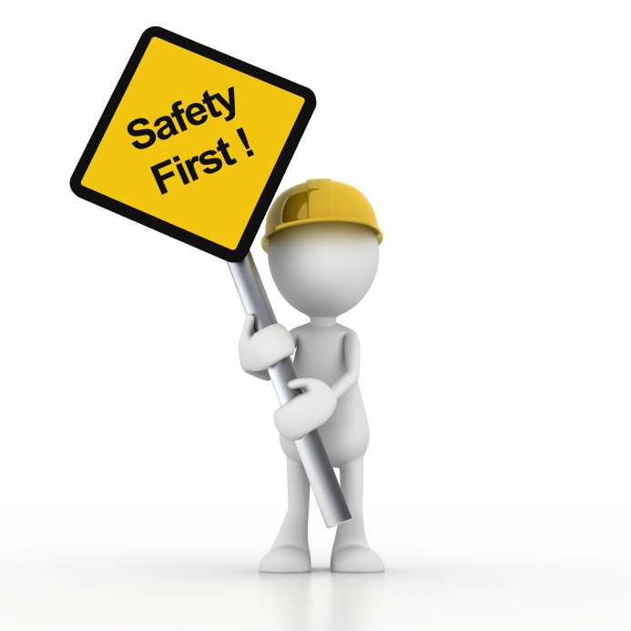
Welding Processes Applied
Gas Tungsten Arc Welding (GTAW)
Shield Metal Arc Welding (SMAW)
Gas Metal Arc Welding (GMAW)
Flux Core Arc Welding (FCAW)
Oxyacetylene Welding (OAW)
Safety Compliance
Daily Toolbox Meeting (TBM)
Personal Protective Equipment (PPE)
Working at high with Full Body Safety Hardness
Method of Statement / Job Safety Analysis (MOS / JSA)
Permit To Work (PTW)

Slide 24
Project Quality Management and 3rd Party Inspection History
Project Client
UT Inspection for Crane Project @ Yangon (2023) - Henan Weihua Heavy Machinery Co., Ltd
UT & Dimension Inspection for Taiwan Project @ Yangon (2023) - Min Dhama Steel Structure Co., Ltd
MT Inspection for Silo Project @ Yangon (2023) - Maezin Co., Ltd
WQT for PEB Project @ Yangon (2023) - PEB Myanmar Co., Ltd Pressure
WQT for MDS Project @ Yangon (2022) - Min Dhama Steel Structure Co., Ltd
MT Inspection for Crane Project @ Yangon (2022) - Tri Stone Engineering Co., Ltd
Testing for Process Piping Project (2021) - Min Dhama Steel Structures Co., Ltd.
Radiographic Testing (RT) for Harbour Project (2021) - Myanmar China Harbour Engineering
Radiographic Testing (RT) for Ywama Steel Mill (3), - MEC & 4E Engineering Group
Revamping Project (2020)
3rd Party Inspection and Ultrasonic Testing (UT) for - Min Dhama & Yokogawa Bridge Corp.
Yangon – Mandalay Railway Improvement Project (2020)
WPS/PQR & WQT for PTTEP 7.5 Mile Project (2020) - Constructive Engineers Ltd.
WQT for Yoma Central, Landmark Project (2020) - Shinyo Thailand Co., Ltd.
3rd Party Inspection and Ultrasonic Testing (UT) for - BMB Vietnam & TAISEI Myanmar
RK Phase III Project @ Thilawa (2019)

Slide 25
Project Quality Management and 3rd Party Inspection History
Project Client
First Solar Project @ HCMC, Vietnam (2018 – 2019) - Exyte Group, Vietnam
Bulacan Cement Mills Project @ Philippine (2018 – 2019) - PEB & Min Dhama Steel Structure
MinDhama Housing Project @ Hlaing TS (2018 – 2019) - Sae Paing Co., Ltd
Denko Oil Storage Tank Terminal Project @ Thilawa (2018) - Myanmar V-Pile Co., Ltd
Green Asia Oil Storage Terminal Project @ Thilawa (2018 - 2019) - CCESCC Co., Ltd
Phayar Chaung Bridge Project (2018) - Shwe Taung Co., Ltd
Yojin Myanmar Cement Plant Project @ Thilawa (2018) - SR E&C / JK Global Co., Ltd
WPS & WQT for Trainer @ Thanlyin (2018 – 2019) - Uniteam Training Co., Ltd
WPQT & WQT for General Project @ Thilawa (2018) - GWH M&E Engineering Co., Ltd
No.2 Ka Mar Kyi Bridge Project @ Yangon (2018) - May Modern Steel Co., Ltd
WQT for M - Tower Project @ Yangon (2018) - Min Dhama Steel Structure Co., Ltd
Inn Sein GTI Warehouse Steel Structure Project (2018) - Triangle Link Co., Ltd
WQT for JFE Jetty project @ Thilawa (2017) - Max Dynamics Co., Ltd
Total Off shore Project @ MOGE Thaketa (2017) - Mega Petroleum Inspection Co., Ltd
WPS & WQT for Tha Htat Oo Airport Project @ Mandalay (2017) - Best Brother United Co., Ltd
Barge & Link Bridge for Power Plant @ Myingyan (2017) - Htun & Win Engineering Co., Ltd

Slide 26
Major Project History (Fabrication & Installation)
Project Client
Pile Installation & Welding work @ Ponnami Project (2023) - Asia Concrete Products Co., Ltd
Fence, Gate & Piping work @ Denko Oil Deport Project - TVC Vietnam
@ SLP (2021 – 2022)
Tank Farm 5 Construction Project @ Pantanaw (2021) - GEAA Industry Public Co., Ltd.
ACMV Piping work @ Yoma Central Landmark Project - Shinryo Thailand
@ Yangon (2020)
ACMV Piping work @ Y Complex Project @ Yangon (2020) - Modair Myanmar
Tank Farm 1 & 2 Construction Project @ Pantanaw (2020) - GEAA Industry Public Co., Ltd.
School Construction Project @ KauThaung (2020) - Ministry of Education
Process Piping work @ Denko Oil Deport Project @ Thilawa (2019)- PENJICO Vietnam
Process Piping work @ Asia World Oil Deport Project - CCESC China
@ Thilawa (2018 - 2019)
Jetty & Steel Structure Project @ Kawthaung (2018) - Grand Andaman Pearl

Slide 27
Major Project History (Fabrication & Installation)
Project Client
Rakhine Low Cost Housing Project @ Rakhaine (2017 - 2018) - KT Construction
Barge & Link bridge for Power Plant Project @ Myingyan (2017) - Semcorp Singapore
SSIP Incineration plant Project @ Shwe Pyi Thar (2016 / 2017) - JFE & YCDC
Showroom Construction Project @ Zawana (2016) - SHARP Myanmar
Army Sport Hall @ Bu Thi Taung (2015) - GE
Ah Par Chi Cement Factory @ Pyi Nyung (2014) - Shwe Taung
Cement Factory @ Ho Pone (2014) - KANBAWZA Group
Hluttaw Kachin State @ Myitkyina (2014) - KACHIN State Government
Army Sport Hall @ Tanine / Moe Kaung (2014) - GE
Graduation Hall @ Myitkyina (2013) - Ministry of Education

Slide 28
Major Project History (Pressure Testing, Pickling and Flushing)
Project Client
Pressure Testing, Pickling and Flushing Services for - LOESCHE GmbH, Germany
Yojin Myanmar Cement Plant @ Thilawa (2018)
Pickling and Oil Flushing Services for JFE Meranti - JFE Meranti Myanmar
Project @ Thilawa (2019)
Flushing with Alkaline Solution, Oil Flushing and - Two Elephant Asia Group
Air Blowing Services @ Shwe Tanung Power Plant (2020)
System Involved – Cooling Water System, Fuel Gas System, Lube Oil System, Compressed Air System, Hydraulic System and etc.

Slide 29
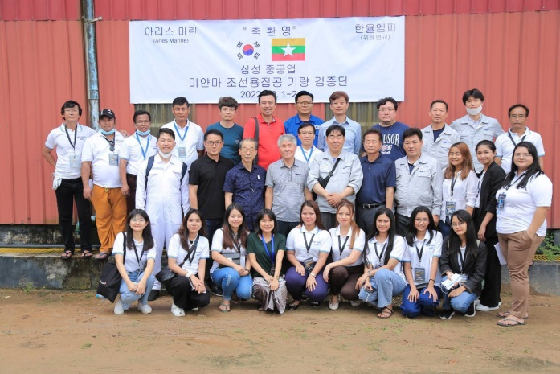
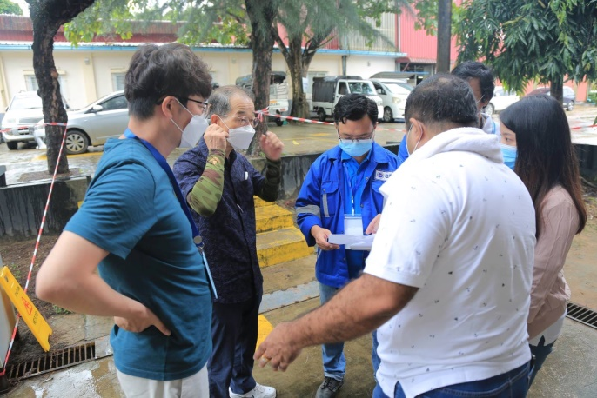
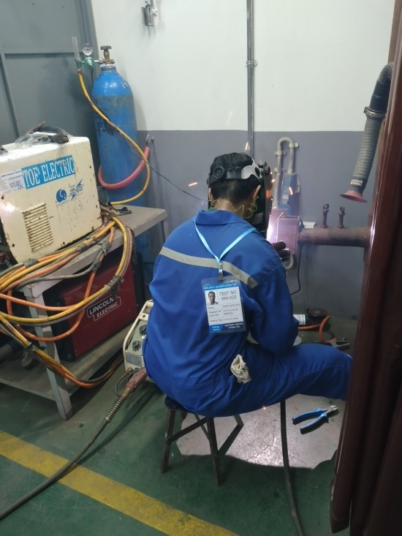
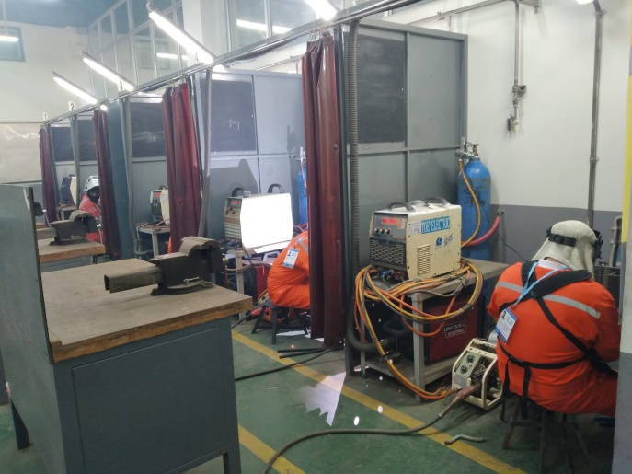
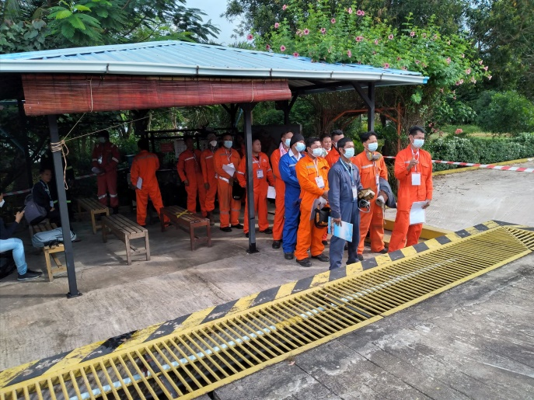
Technical Expert Services, Facilities & Overall WQT Management
Welder Qualification Test of SAMSUNG Shipyard (2022)

Slide 30
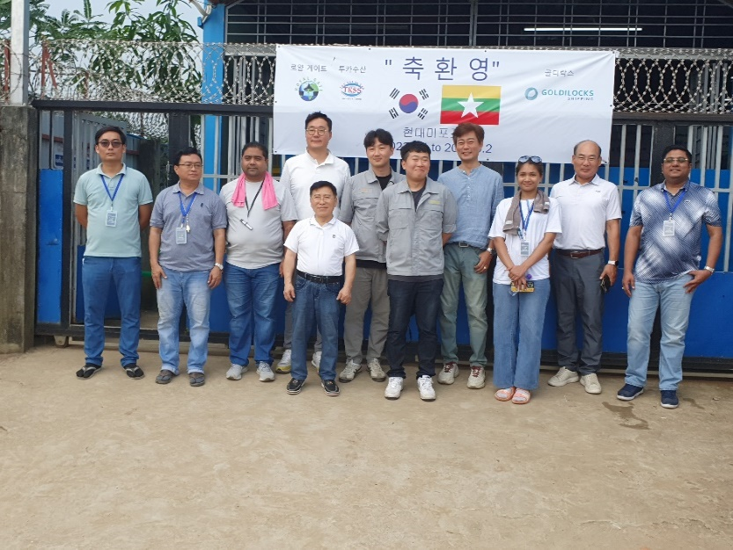
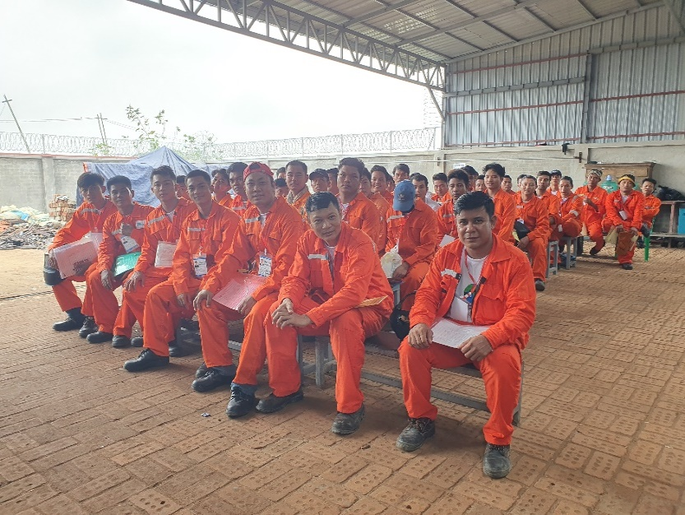
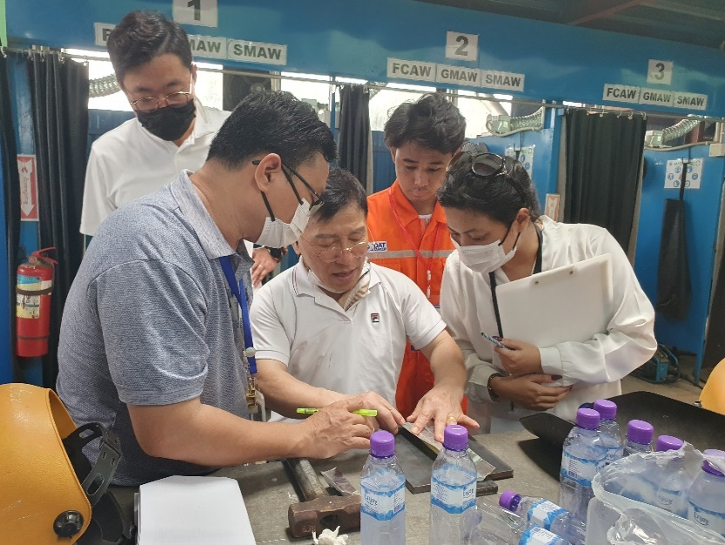
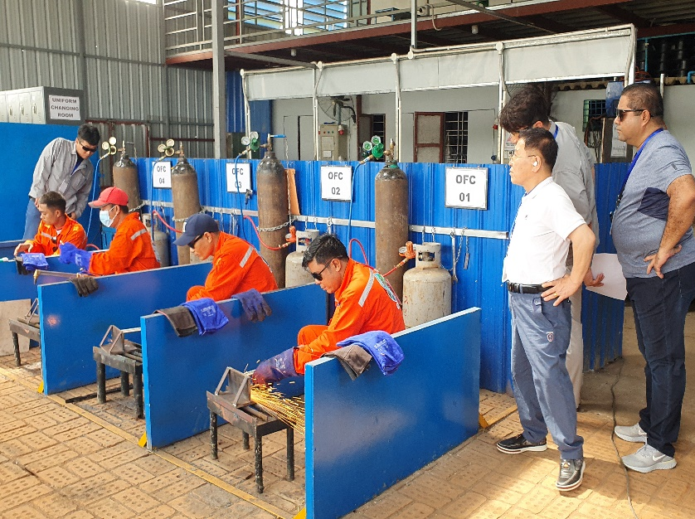
Technical Expert Services, Facilities & Overall WQT Management
Welder Qualification Test of HHI Shipyard (2023)

Slide 31
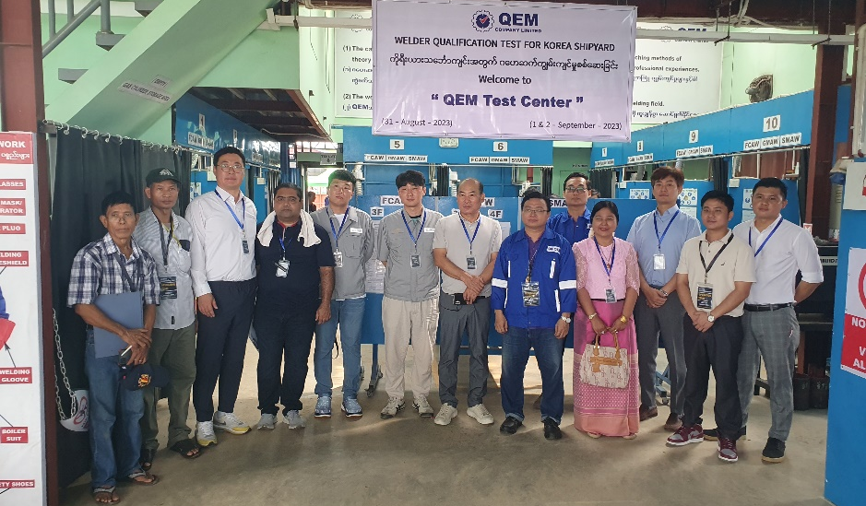
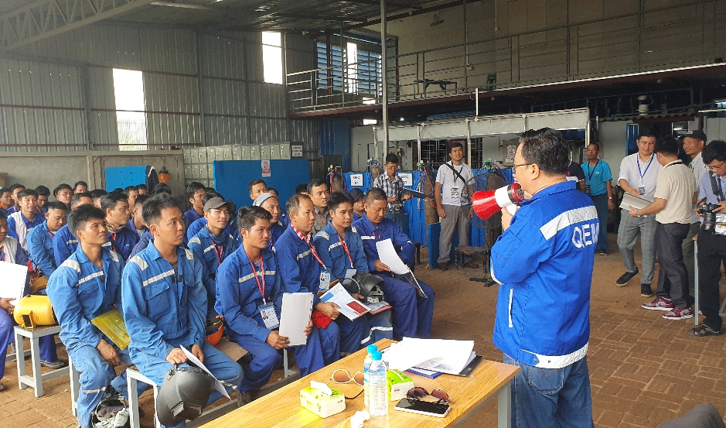
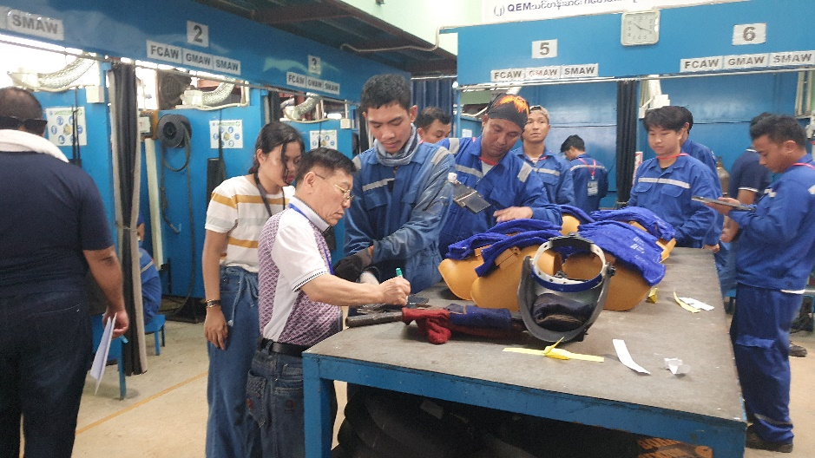
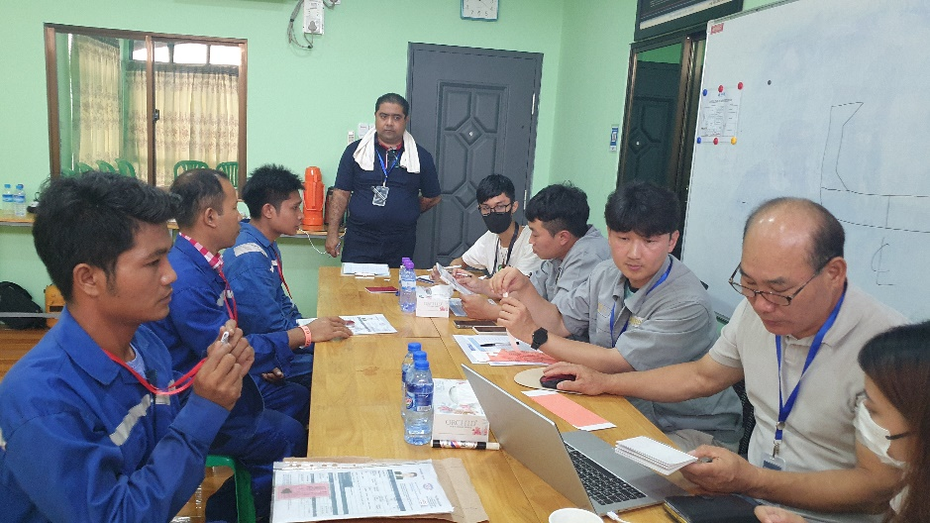
Technical Expert Services, Facilities & Overall WQT Management
Welder Qualification Test of HHI Shipyard (2023)

Slide 32
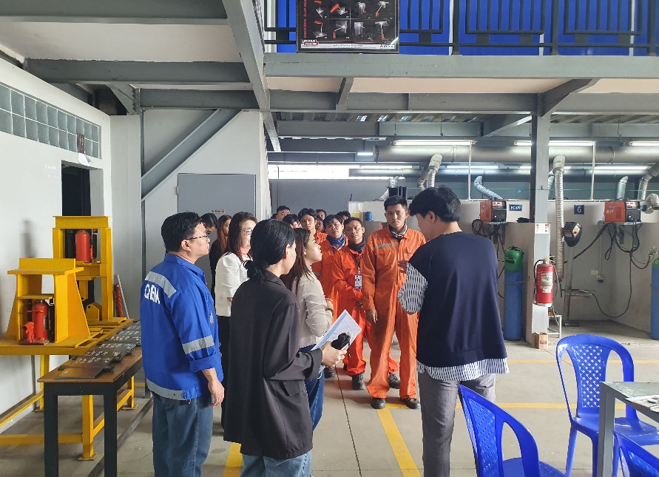
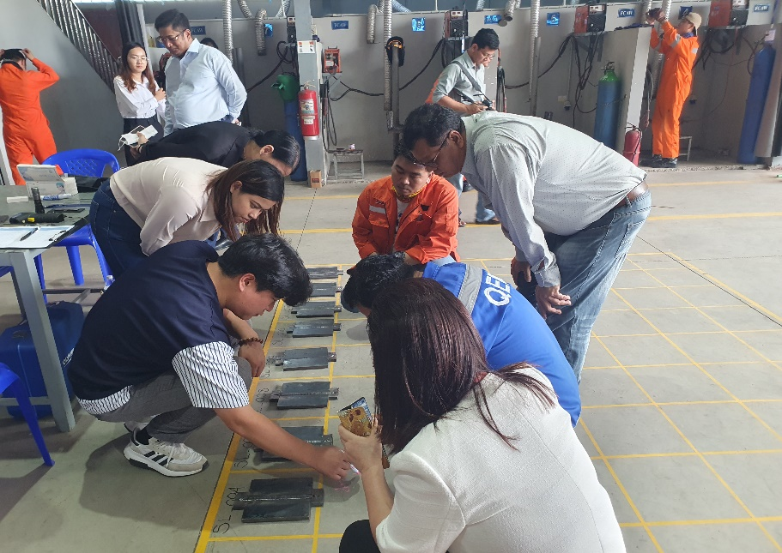
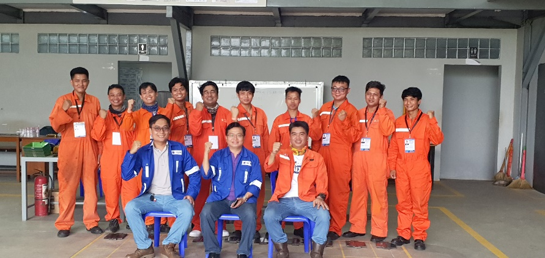
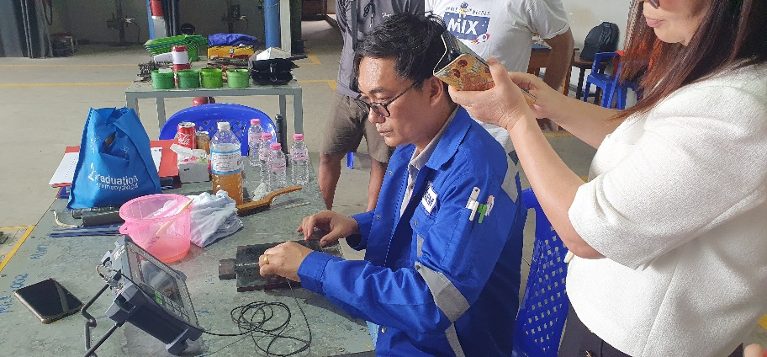
Technical Expert Services, Training,
NDT & Overall WQT Management
Welder Qualification Test of SAMSUNG Shipyard (2024)

Slide 33





Welder Qualification Inspection
Inspection for WQT of PEB Myanmar Company Limited

Slide 34





Welder Qualification Inspection
Inspection for WQT at Arbourfield Training Center (2023)

Slide 35





Welder Qualification Inspection
Inspection for WQT at New Idea Training Center (2024)

Slide 36




Welder Qualification Inspection
Inspection for WQT of Uniteam Training Center (2023)

Slide 37


Welder Qualification Inspection
UT Inspection for WQT of Myanma Shipyard Training Center (2023)

Slide 38




Welder Qualification Inspection
Inspection for WQT of Kyaw Thar Engineering & Construction Co., Ltd.

Slide 39




Welder Qualification Inspection
Inspection for WQT of Min Dhama Company Limited.

Slide 40





Welder Training and Qualification
Accordance with AWS D1.1 / ASME Sec. IX

Slide 41





Welder Training and Qualification
Accordance with AWS D1.1 / ASME Sec. IX

Slide 42




Welder Training and Qualification
Accordance with AWS D1.1 (1G / 2G / 3G / 4G)
2G
1G
4G
3G

Slide 43




Welder Training and Qualification
Marine Welder and Fitter Performance Test

Slide 44



Welder Training and Qualification
Welding Procedure Qualification for Grand Ocean (Thailand) Co., Ltd

Slide 45





Welder Training and Qualification
Accordance with ASME Sec. IX (6G)

Slide 46







Safety Compliance

Slide 47






Welding Procedure Qualification Test
Test Specimen and Mechanical Testing

Slide 48






Third Party Inspection

Slide 49




Third Party Inspection

Slide 50






Third Party Inspection

Slide 51






Third Party Inspection

Slide 52






Third Party Inspection

Slide 53






Blasting and Painting Inspection

Slide 54



Thermoplastic Piping Qualification and Installation

Slide 55






Process Piping Fabrication and Installation
Fit-up
Root Pass
SMAW Weld Profile
GTAW Weld Profile
SS Fillet Weld
Weld Map & Traceability

Slide 56




Process Piping Fabrication and Installation

Slide 57






Hot Tapping on Existing Piping System

Slide 58






Pressure Testing, Chemical / Oil Flushing

Slide 59




Piping Installation, Insulation & Cladding

Slide 60



Piping Installation, Insulation & Cladding

Slide 61




Steel Structure Fabrication & Erection

Slide 62




Steel Structure Fabrication & Erection

Slide 63




Storage Tank Fabrication & Erection

Slide 64




Storage Tank Fabrication & Erection

Slide 65



Barge & Link Bridge Fabrication & Inspection

Slide 66
End of Profile
Thank you

